Slide 1
Electric Vehicle Data Analysis
Presented By Josh Magnan & Ryan Somers

Slide 2
Table of Contents
01
02
03
04
Introduction
Conclusion
Introduce the dataset...
05
Conclude our presentation
Market Analysis and Target
Talk about certain trends...
Our Process
Talk about cleaning the data, creating visuals...
Key Findings
Talk about our findings/answers...

Slide 3
01
Introduction
01
Contains data on electric vehicles registered in Washington State

Slide 4
Our Objective
EV
To analyze this dataset & derive insights regarding electric vehicle adoption, performance , and trends

Slide 5
02
Market Analysis
The COVID Trend...
And Tesla's Dominance
02

Slide 6
Understanding the EV Landscape in Washington State
Tesla Dominance
COVID-Era Spike
Range Evolutions
Tesla accounts for nearly 30% of all EVs in the dataset
EV registrations surged between 2020-2022, likely incentives
Newer models show a clear upward trend in electric range

Slide 7
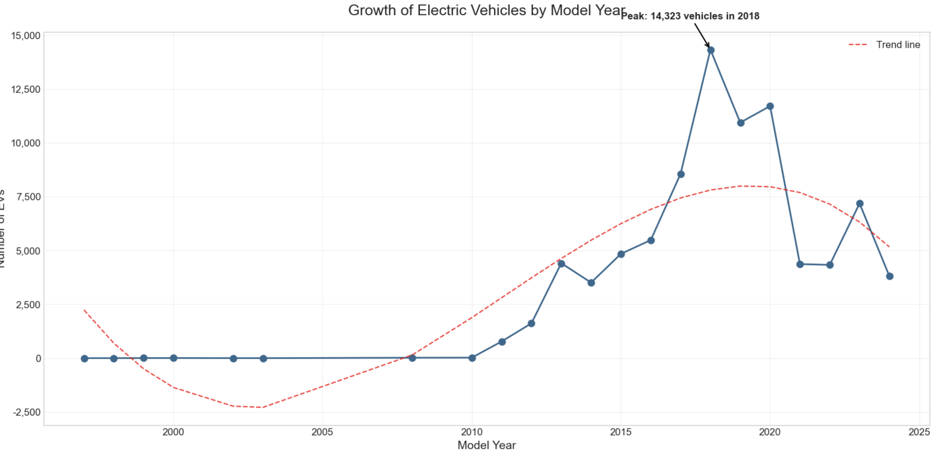

Slide 8
Our Process
Data Cleaning
Feature Engineering
01
02
Removed vehicles with 0-mile range, filled missing values, and standardized model names
Grouped models for trend analysis
Outlier Detection
Visualization
03
04
Flagged extreme values to ensure accurate results
Used Pandas, Seaborn, and Matplotlib for trend exploration
03

Slide 9
Whoa!
04
What the Data Reveals About EV Trends

Slide 10
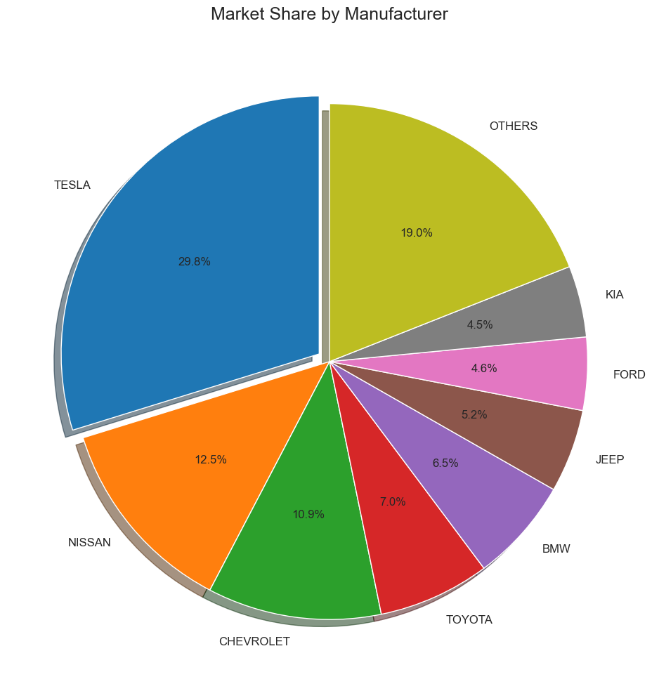
Tesla Leads the Pack
30%
45K
Of all EVs in the state of Washington
here

Slide 11
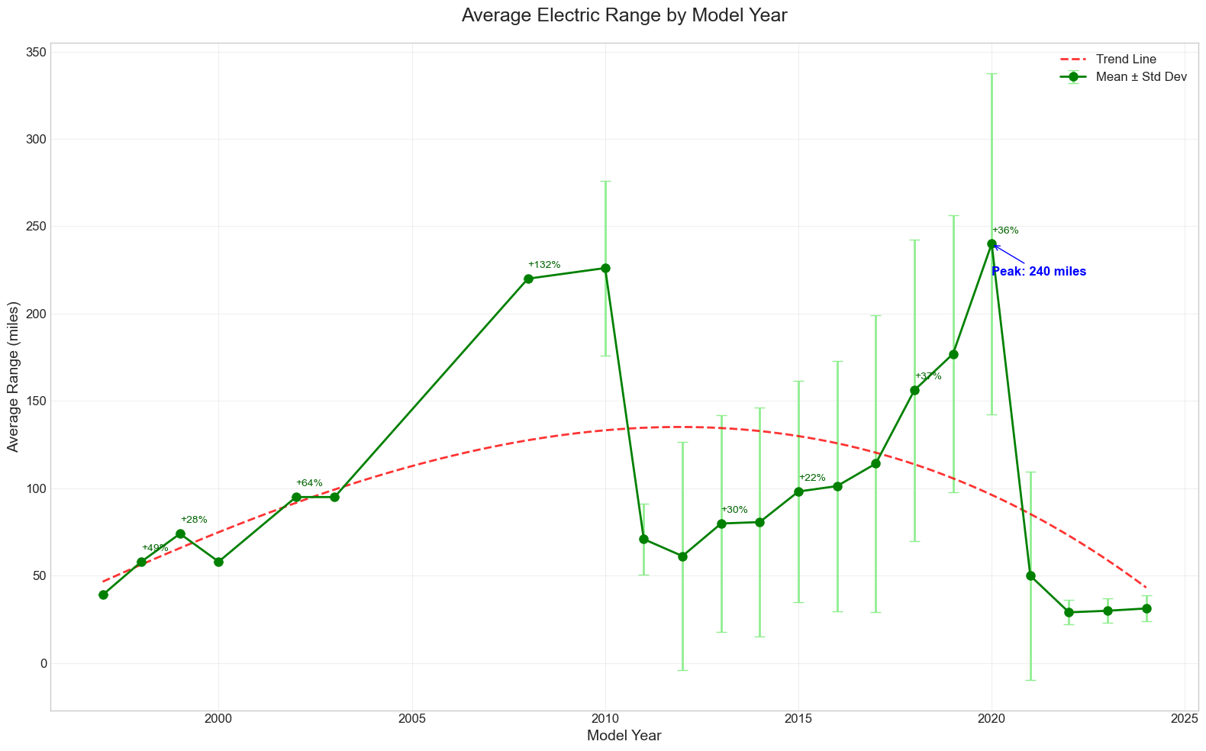
Range is Rising
Average electric range has been increasing in recent years peaking at over 300 miles

Slide 12
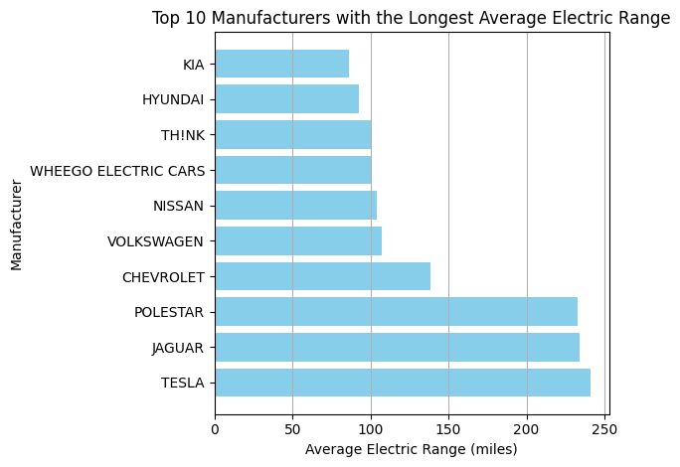
Tesla has the largest Electric Range on average

Slide 13
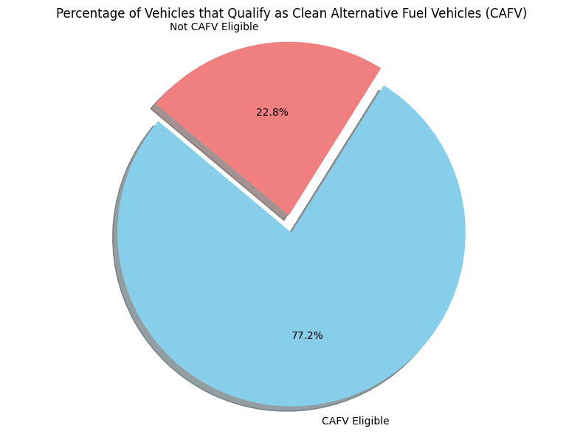
EV's are becoming "Clean"
77%

Slide 14
Conclusion
05
Trends Over Time: The average electric range has improved over the years, reflecting advancements in battery technology and design. This trend is encouraging for potential buyers, as it suggests that newer models will continue to offer better performance.
Market Share Trends: The analysis of market share from 2013 to 2023 showed that certain manufacturers dominate the electric vehicle market, while others are emerging. This indicates a competitive landscape!
CAFV Eligibility: A significant percentage of vehicles qualify as Clean Alternative Fuel Vehicles, which is a positive indicator for environmental initiatives and policies aimed at promoting cleaner transportation options.

Slide 15
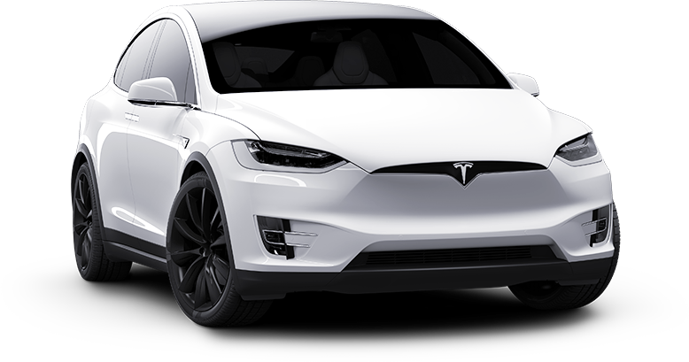
THANK YOU FOR LISTENING!

